Slide 1
STATEWIDE WATER EDUCATION ACTION PLAN (SWEAP)
SCW CONFERENCE
10.05.21
“Colorado’s first statewide education action plan designed to support the Water Plan’s goal of sustainable water by 2050.”
JAYLA POPPLETON
SCOTT WILLIAMSON
Executive Director
Water Education Colorado
Education Programs Manager
Water Education Colorado
Notes:
Hello, and welcome to an overview of the Statewide Water Education Action Plan, Colorado’s first statewide education action plan designed to support the Water Plan’s goal of sustainable water by 2050. My name is Scott Williamson and I am the Education and Outreach Coordinator at Water Education Colorado.

Slide 2
INTRODUCTIONS
Name
Organization
What is your experience with a public awareness campaign?

Slide 3
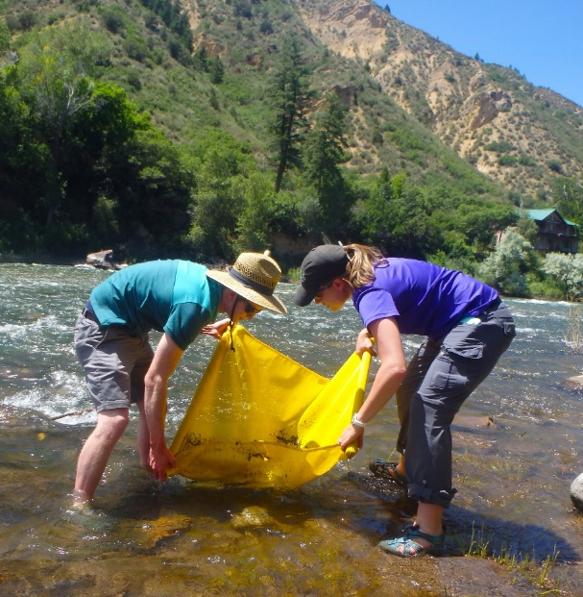
PURPOSE AND AGENDA
By the end of the workshop, attendees will be able to:
• Describe the purpose for Water ’22 and its connection to the strategic framework of the Statewide Water Education Action Plan (SWEAP)
• Identify opportunities to connect your program and messaging to the Water ’22 campaign
• Apply peer learning through a participant-driven case study analysis

Slide 4
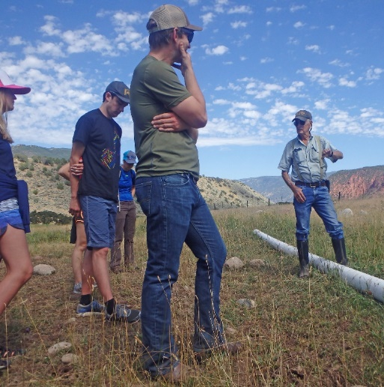
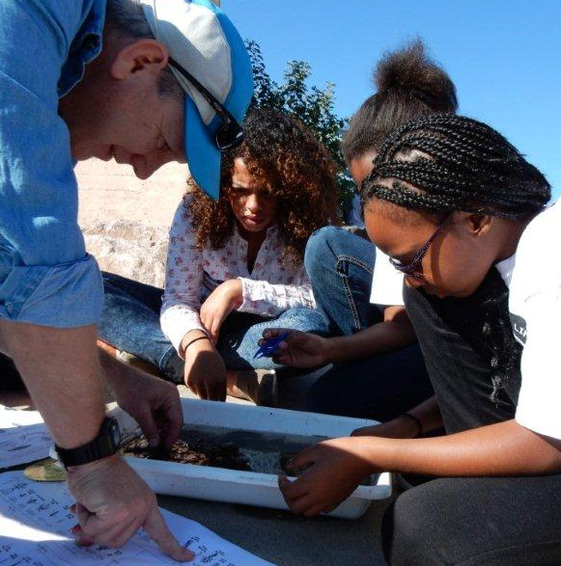
ALIGNMENT PLANNING
Answer the following questions to help align programs together for Water ‘22
1
OBJECTIVE & MESSAGE
What is the objective, key message, audience, and geographic focus for your idea or program?
2
FIT TO WATER ‘22
Why is this particular program a good fit to Water ‘22? How do you see Water ’22 elevating this program/expanding its reach?
3
RESOURCES & QUESTIONS
What resources would be beneficial and what questions do you need answered to connect your organization/program to Water ‘22?
4
NEXT STEPS
What are you going to do after this conference to make sure this connection happens?

Slide 5
ALIGNMENT TO WATER ‘22
Objective & Message | Fit to Water ‘22 | Resources/Questions | Next Steps
Objective: Message: Audience: Geographic Focus: |  | Resource/guidance needs: Questions: | Who: By when:

Slide 6
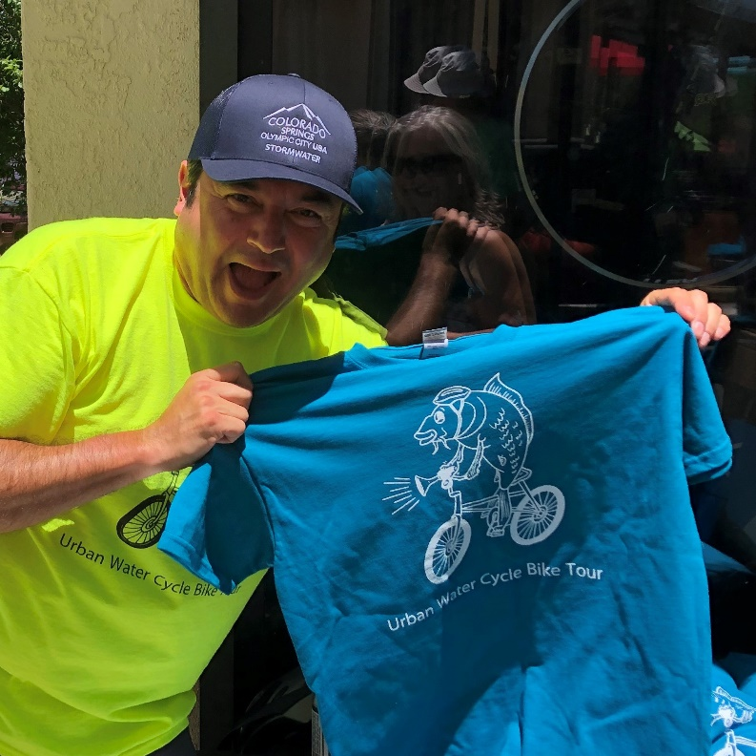
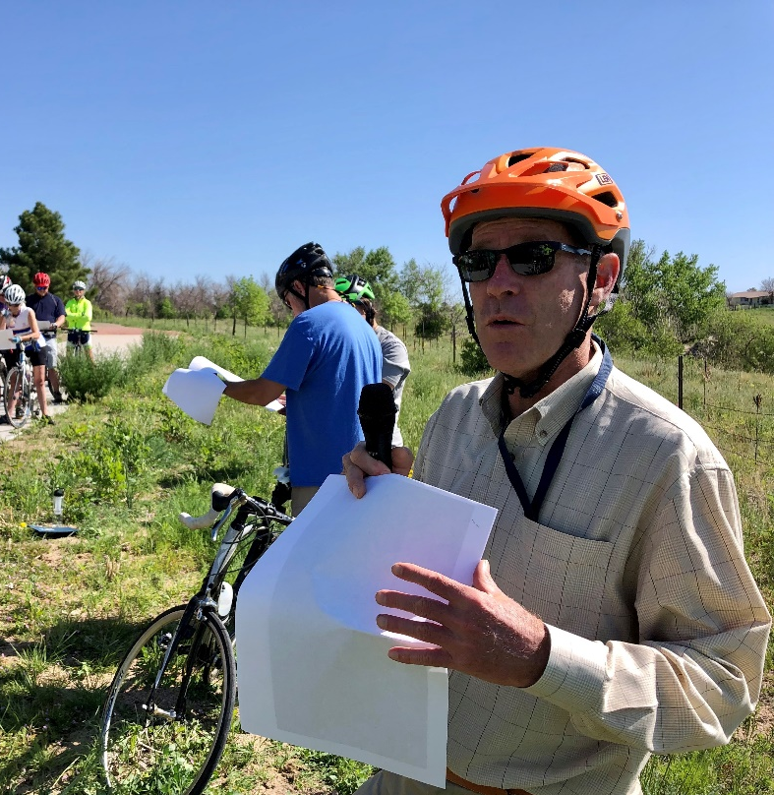
ALIGNMENT PLANNING
Answer the following questions to help align programs together for Water ‘22
1
OBJECTIVE & MESSAGE
What is the objective, key message, audience, and geographic focus for your idea or program?

Slide 7
ALIGNMENT TO WATER ‘22
Objective & Message | Fit to Water ‘22 | Resources/Questions | Next Steps
Objective: Connect public to their waterways to better understand human impact & management; Inspire stewardship. Message: water connects us as community and our actions matter Audience: Active adults? Geographic Focus: Denver Metro, Colorado Springs Metro |  | Resource/guidance needs: Questions: | Who: By when:

Slide 8
ALIGNMENT PLANNING
Answer the following questions to help align programs together for Water ‘22
2
FIT TO WATER ‘22
Why is this particular program a good fit to Water ‘22? How do you see Water ’22 elevating this program/expanding its reach?

Slide 9
ALIGNMENT TO WATER ‘22
Objective & Message | Fit to Water ‘22 | Resources/Questions | Next Steps
Objective: Connect public to their waterways to better understand human impact & management; Inspire stewardship. Message: water connects us as community and our actions matter Audience: Active adults? Geographic Focus: Denver Metro, Colorado Springs Metro | Fit to Campaign: 10th anniversary of the Urban Water Cycle Tour Series For WEco, a program that reaches interested citizens outside of the water world Naturally fun and engaging Ready for a refresh? | Resource/guidance needs: Questions: | Who: By when:

Slide 10
ALIGNMENT PLANNING
Answer the following questions to help align programs together for Water ‘22
3
RESOURCES & QUESTIONS
What resources would be beneficial and what questions do you need answered to connect your organization/program to Water ‘22?

Slide 11
ALIGNMENT TO WATER ‘22
Objective & Message | Fit to Water ‘22 | Resources/Questions | Next Steps
Objective: Connect public to their waterways to better understand human impact & management; Inspire stewardship. Message: water connects us as community and our actions matter Audience: Active adults? Geographic Focus: Denver Metro, Colorado Springs Metro | Fit to Campaign: 10th anniversary of the Urban Water Cycle Tour Series For WEco, a program that reaches interested citizens outside of the water world Naturally fun and engaging Ready for a refresh? | Resource/guidance needs: Water ‘22 messages or themes to organize tour topics and speakers around. Centralized calendar to advertise the event Water ’22 and/or anniversary logo to spice up the brand Questions: Who runs the calendar? Will we have resources to run this tour in Spanish? | Who: By when:

Slide 12
ALIGNMENT PLANNING
Answer the following questions to help align programs together for Water ‘22
4
NEXT STEPS
What are you going to do after this conference to make sure this connection happens?

Slide 13
ALIGNMENT TO WATER ‘22
Objective & Message | Fit to Water ‘22 | Resources/Questions | Next Steps
Objective: Connect public to their waterways to better understand human impact & management; Inspire stewardship. Message: water connects us as community and our actions matter Audience: Active adults? Geographic Focus: Denver Metro, Colorado Springs Metro | Fit to Campaign: 10th anniversary of the Urban Water Cycle Tour Series For WEco, a program that reaches interested citizens outside of the water world Naturally fun and engaging Ready for a refresh? | Resource/guidance needs: Water ‘22 messages or themes to organize tour topics and speakers around. Centralized calendar to advertise the event Water ’22 and/or anniversary logo to spice up the brand Questions: Who runs the calendar? Will we have resources to run this tour in Spanish? | Who: Scott talks with Amy to get her reactions; Scott sets up a meeting with C Springs team By when: Next week (just send out a calendar invite already!)

Slide 14
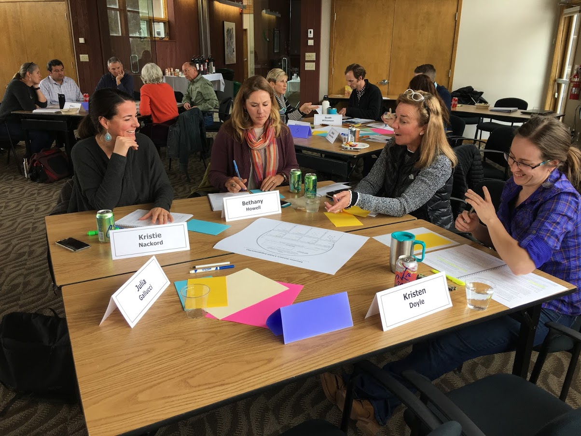
GROUP DISCUSSION
What common themes do you see in the group’s areas of alignment?
What are common questions or resource needs?
What new ideas or opportunities might exist for working together?
How can we leverage WEN and each other to support this work?
What is your next step (What, who, when, how)?

Slide 15
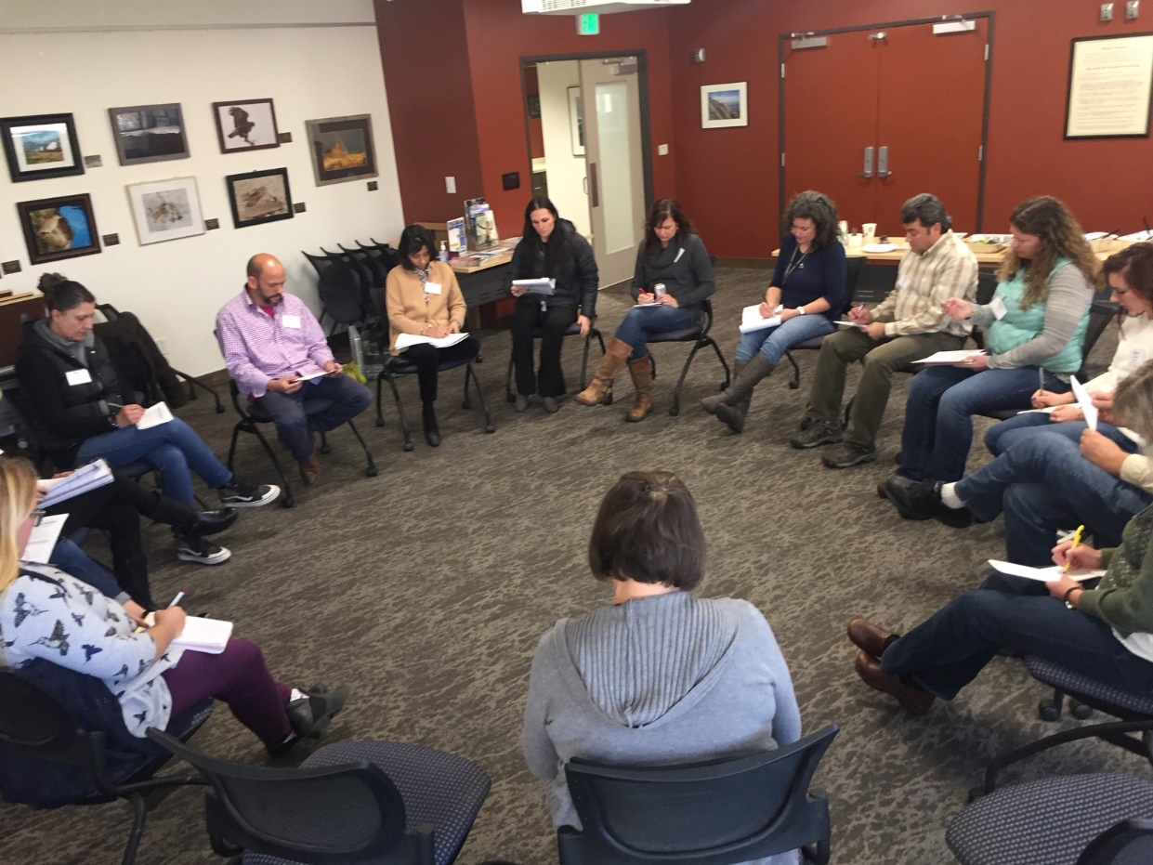
CASE STUDIES
Tips for a good case study:
Start and end with an open-ended question.
Centrally involve water education content or programming.
Proceed from a concrete situation.
Be brief. (Don’t vent ☺)

Slide 16
CASE STUDIES
(3 mins) The presenter reads their case.
(5 mins) The participants ask clarifying questions of the presenter.
(2 mins) Everyone writes on the presenter’s question.
(10 mins) The participants discuss the case. The presenter takes notes, but remains silent.
(2 mins) Everyone reflects one final time.
(3 mins) The presenter reflects on the suggestions they received and discusses their follow-up action plan.

Slide 17
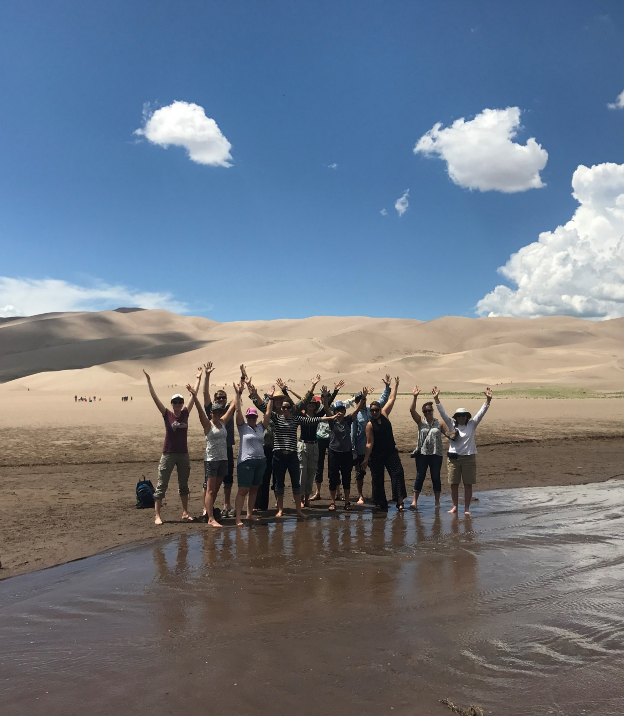
Let’s work together on this!
Jayla Poppleton, WEco Executive Director
Jayla@wateredco.org I 720-325-1448
Scott Williamson, WEco Ed. Programs Manager
Scott@wateredco.org I 303-377-4433
Notes:
Let’s work together on SWEAP. Please reach out and connect with us using the contact information on this slide. Contact Jayla Poppleton or myself, Scott Williamson. Thank you for taking the time to learn about SWEAP. We look forward to connecting with you soon.

