Slide 1
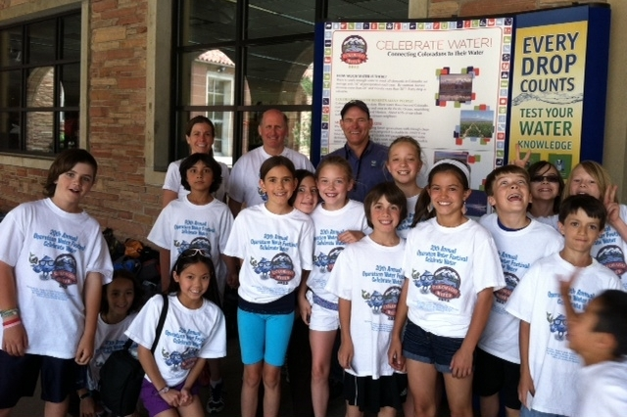

WATER 2022 (WATER ’22)
WEco Pre-Conference Workshop
10.5.21
JAYLA POPPLETON
Executive Director
Water Education Colorado
SCOTT WILLIAMSON
Education Programs Manager
Water Education Colorado

Slide 2
TODAY’S OUTLINE
A brief overview of what this presentation will cover…
HOW DOES WATER ’22 CONNECT WITH SWEAP?
VISION FOR WATER ‘22
IDEATION
WHAT IS WATER ‘22?
We’ll discuss the role of building awareness in water education, the history of Water 2012, and an outline of Water ‘22
Learn how Water ’22 connects to the SWEAP framework , its awareness outcome, and related strategy(ies)
Learn about the plans for Water ’22 and opportunities to participate
Discuss Water ’22 basin events and put your creative thinking caps on

Slide 3

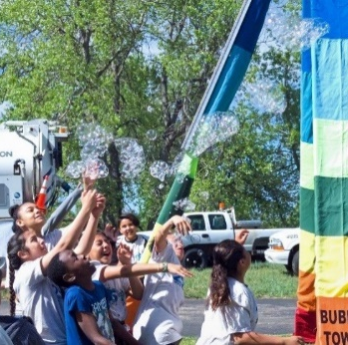
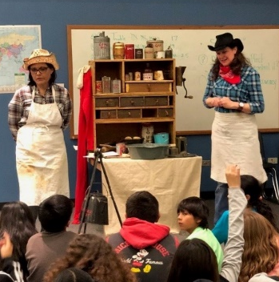
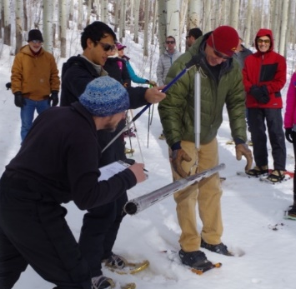
WHY AWARENESS?
“Being conscious of something”
“A state wherein a subject is aware of some information when that information is directly available to bring to bear in the direction of a wide range of behavioral actions”
Goal is often to affect attitudes, perceptions and behavior
Notes:
Think about a time when you became aware of something that really piqued your interest, caught your attention, and activated you to make some kind of change or commitment. Public education, participation and outreach involves awareness building. And for WEco, it is an entry point on a continuum of working to accomplish our mission of informed water stewardship.

Slide 4

“
VISION:
Large, coordinated statewide effort
Raise public awareness about water as a valuable and limited resource.
Connect Coloradans to existing and new opportunities to learn about water.
Motivate Coloradans to become more proactive participants in Colorado’s water future.
Showcase exemplary models of cooperation and collaboration among Colorado water users.
Increase support for management and protection of Colorado’s water and waterways.
WATER ‘22
Building off of Water 2012
“
Notes:
Unique anniversaries were being celebrated:
75th Anniversaries
Colorado Water Conservation Board
Northern Colorado Water Conservancy District
Colorado River Water Conservation District
50th Anniversary
Southeastern Colorado Water Conservation District
10th Anniversary
Colorado Foundation for Water Education

Slide 5
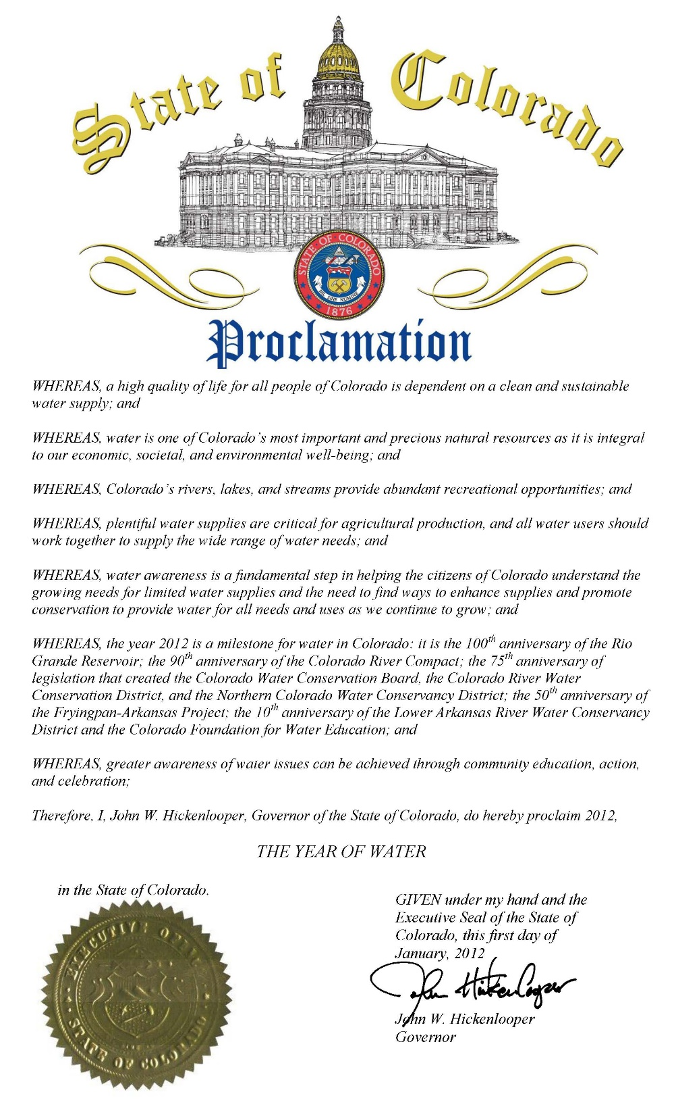
WATER 2012
The “Year of Water”…
Gov. Hickenlooper, Jan. 1, 2012:
“Whereas ,water awareness is a fundamental step in helping the citizens of Colorado understand the growing needs for limited water supplies and the need to enhance supplies and promote conservation to provide water for all needs and uses as we continue to grow….”

Slide 6
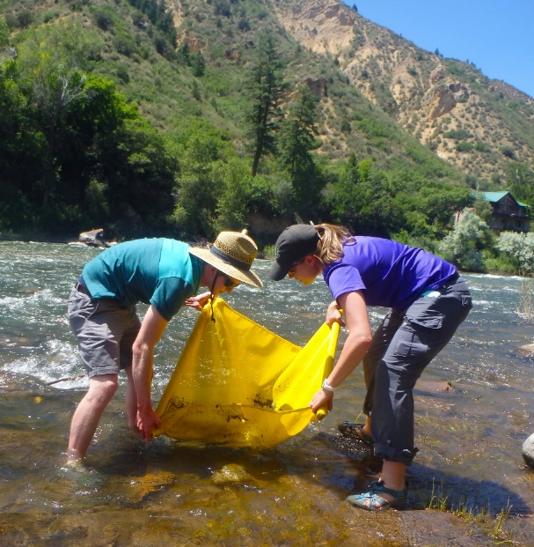
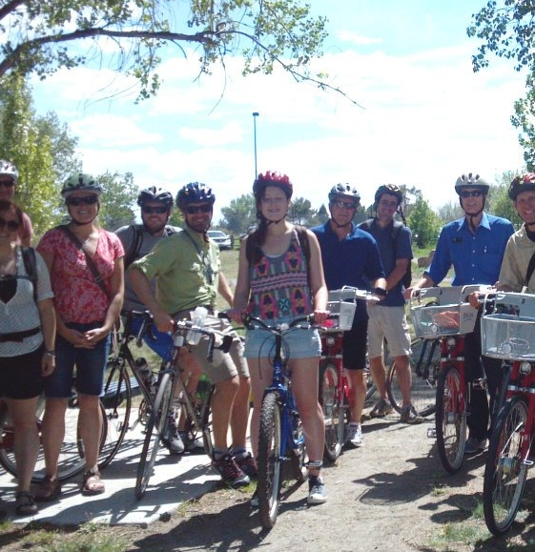

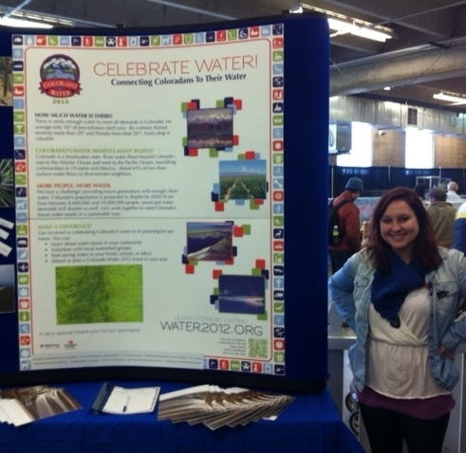
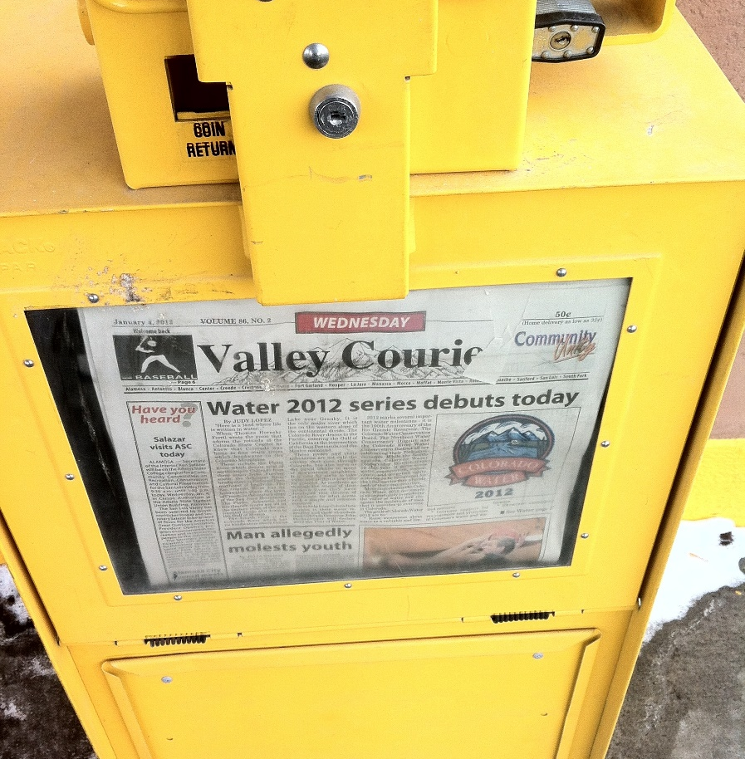
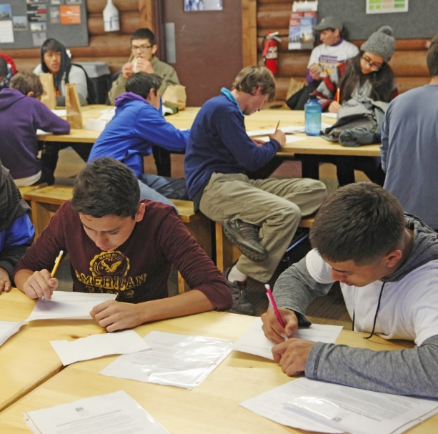
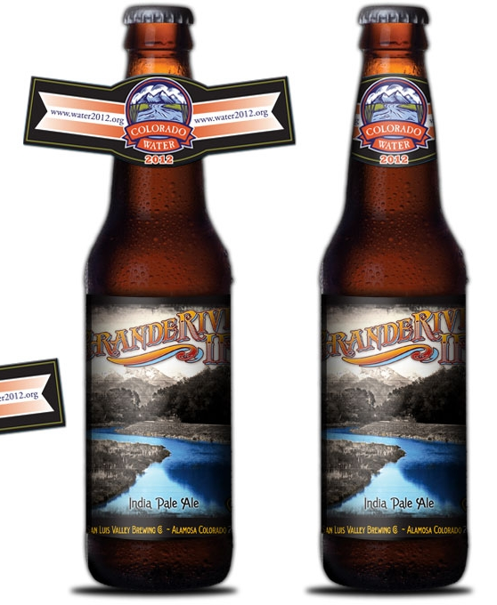
WATER 2012 IMPACT
More than 600 participating entities utilizing “toolkit” with common branding and messaging
430 events hosted by over 200 organizations with high level of volunteer engagement
More than 500,000 people interacted with the campaign in some form
Water Educator Network was born!
Notes:
Water 2012 accomplishments can be attributed to the implementation of activities at the local, regional, and statewide levels, where countless professionals and numerous dollars were used to deliver Water 2012 educational programs and awareness activities. These local, regional and statewide activities were branded together through a “toolkit.” The “toolkit” contained programs and activities, and was used by over 600 partners across the state.
Six committees developed and oversaw the following activities
Website and social media
Central event calendar
Library and Museums
Special issue Water 101 Headwaters Magazine
Traveling library display
Book club and reading list
Colorado author talks w/ Colorado Humanities
Speaker’s Bureau
Basic water and history presentation to civic groups
Experts available for specific topics
Higher Education
Professional networking events for students
K-12
Photo contest
Coordination of water festivals
There were also some challenges: Colorado Water 2012 was less successful at creating behavior change among the general public
High level of coordination among volunteers was required
To meet the goals of so many different organizations, Water 2012 had to be broad and not advocacy focused

Slide 7
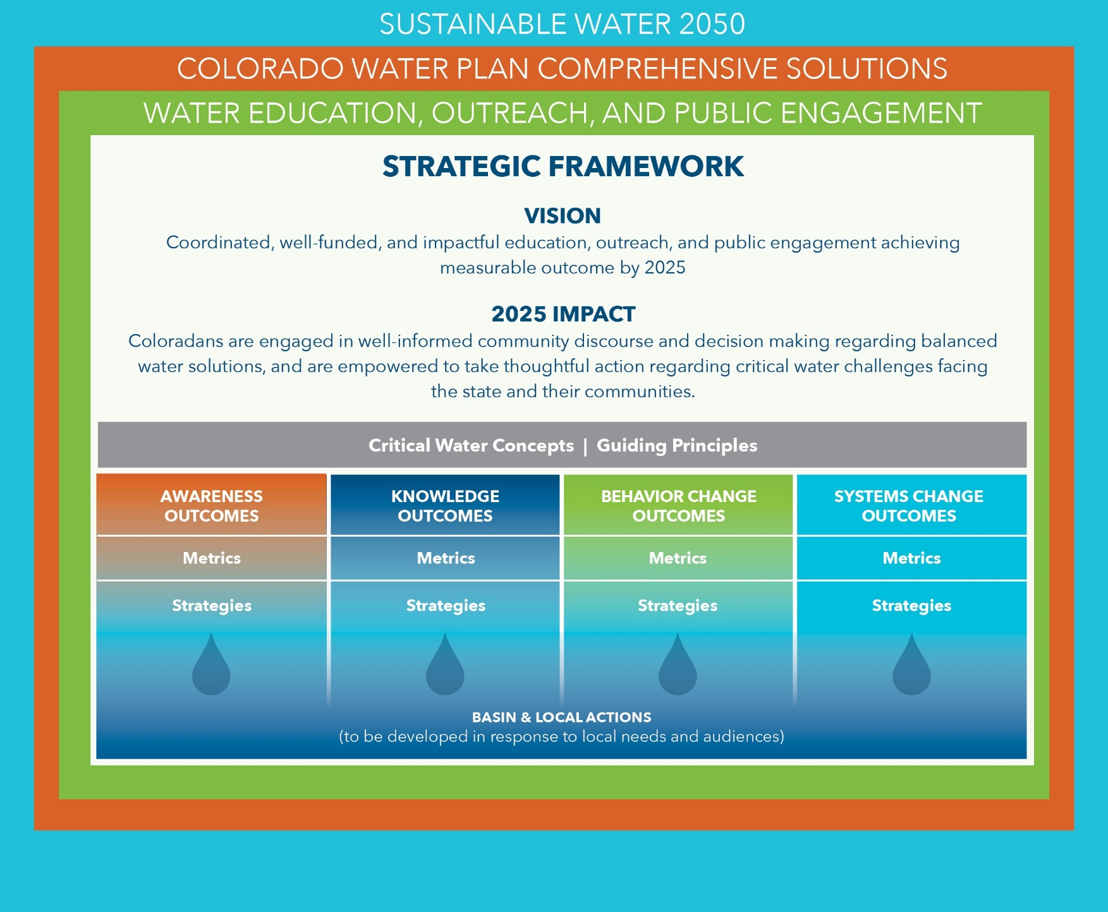

STRATEGIC FRAMEWORK/ EDUCATION CONTINUUM
“With a shared vision, guiding principles, and a core set of shared outcomes, individual actions will achieve the greatest possible impact – both locally and statewide.”
Notes:
SWEAP is a five year plan that is Colorado specific. It lays out a shared vision that will advance Colorado’s water plan. The idea is that coordinated action will achieve the greatest possible impact. Audiences are varied depending on which organizations are participating and their unique objectives, so it is not a prescriptive plan. It is meant to be flexible and inclusive of educators working with audiences from decision makers to community members to youth, our future leaders. (My son who just started his freshman year will be 43 years old in 2050!)
The Strategic Framework is the backbone of SWEAP and is built around the idea that with a shared vision, guiding principles, and a core set of shared outcomes, individual actions will achieve the greatest possible impact – both locally and statewide.
Notice that the strategic framework is contained within the Water Plan Goal of Sustainable Water by 2050, the Water Plan Solutions, and the Water Education, Outreach and Public Engagement chapter of the water plan.
The SWEAP education continuum is carried forward into the Strategic Framework for SWEAP and helps organize the SWEAP outcomes.
On this continuum, awareness is the first step toward engagement.

Slide 8
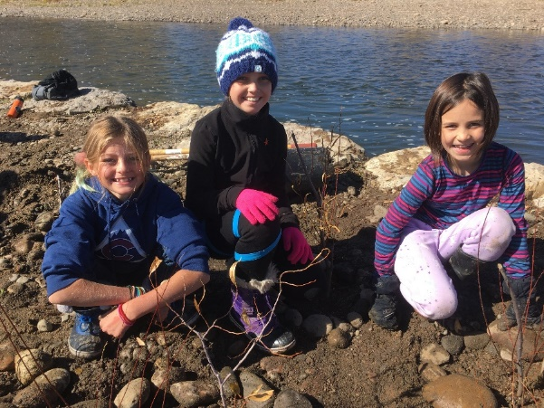
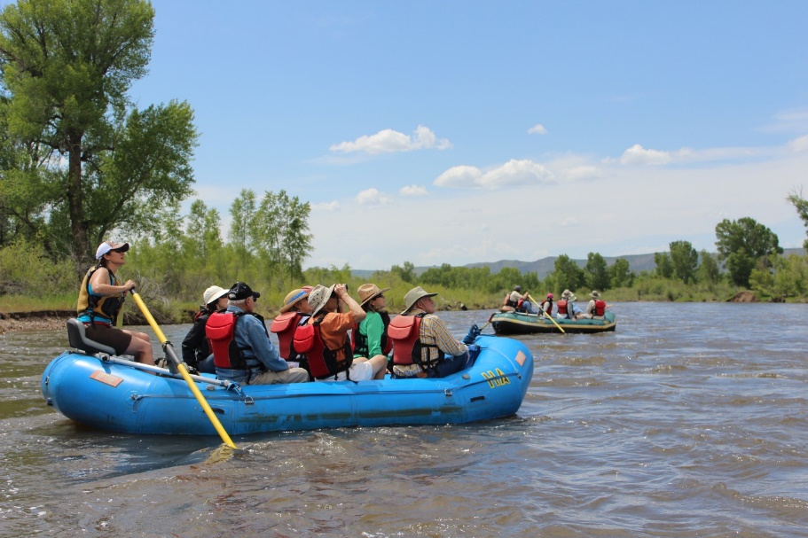
SAMPLE OUTCOMES
Some examples of the 10 SWEAP outcomes…
1
AWARENESS
The proportion of Coloradans (in each river basin) who can identify how water supports their quality of life, as well as the threats to and potential solutions for a sustainable water supply, increases.
2
KNOWLEDGE & SKILLS
The proportion of Coloradans in each river basin who report confidence in having the knowledge necessary to take an active role in water stewardship in their community increases.
.
5
BEHAVIOR CHANGE
Participation in community discourse and decision processes about water at the state, regional and local levels increases.
7
BEHAVIOR CHANGE
The proportion of Coloradans that are demonstrating sustainable water behaviors increases.
.
Notes:
There are10 SWEAP outcomes and they are nested under the continuum categories. They are all important and cross over and influence each other. There is one awareness outcome, and that is the most direct connection to the Water ’22 effort ,but we also see opportunities to advance these three other outcomes as well. This is where pointing to opportunities to learn more and engage come in… importance of including calls to action. How do we inspire, direct, guide and incentivize behavior change?

Slide 9
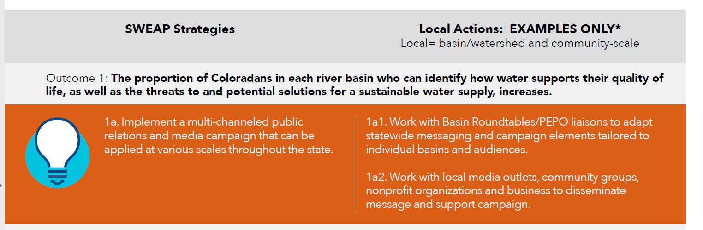
OUTCOMES - ACTIONS
Notes:
We worked with the SWEAP Coalition and Water Educator Network affiliates to help identify the most promising strategies to advance the SWEAP outcomes, as well as example actions on different scales. In this case, we are advancing this SWEAP strategy and these actions very specifically with Water ’22, but it is important to note these aren’t the only possible strategies, nor will the work be done at the conclusion of Water ’22.

Slide 10
WATER ’22 OBJECTIVES
Make progress on Statewide Water Education Action Plan outcomes, especially 1, 2, 5 and 7, focused on awareness, knowledge, participation and adoption of sustainable water behaviors.
Support the PEPO liaisons as they work to highlight the role of the Basin Roundtables and the Basin Implementation Plans in conjunction with the above outcomes.
Support the CWCB as it works to highlight its role and the role of the Colorado Water Plan in conjunction with the above outcomes.
Invigorate the Water Educator Network, which itself was an outcome of the extensive collaborations and partnerships fostered during Water 2012, with an exciting, collaborative campaign that demonstrates impact.
Notes:
Digging in a little deeper to the goals/objectives of Water ’22 specifically, we see the following: The overall project objective will be to engage and motivate Coloradans to take an active role in water stewardship in their communities through a statewide celebration of water’s role in shaping Colorado that raises awareness and points to additional educational resources and opportunities
SWEAP Outcome 1 (Awareness outcome): “The proportion of Coloradans in each river basin who can identify how water supports their quality of life, as well as the threats to and potential solutions for a sustainable water supply, increases.”
SWEAP Outcome 5 (Behavior change outcome): “Participation in community discourse and decision processes about water at the state, regional and local levels increases.”
SWEAP Outcome 7 (Behavior change outcome): “The proportion of Coloradans in each river basin that are demonstrating sustainable water behaviors increases.”

Slide 11
RESOURCES
“
VISION:
Large, coordinated statewide effort
Raise public awareness about water as a valuable and limited resource.
Connect Coloradans to existing and new opportunities to learn about water.
Motivate Coloradans to become more proactive participants in Colorado’s water future.
Showcase exemplary models of cooperation and collaboration among Colorado water users.
Increase support for management and protection of Colorado’s water and waterways.
What products, resources or tools would best enable your organization’s participation?
Shared Water ’22 messaging (slogan(s), calls to action, etc.) customizable locally
Communications/Media Toolkit and Training on Usage (may include designed ads and/or video or radio spots that could be customized locally)
Shareable campaign collateral that partnering entities will have access to (e.g. postcards, t-shirts, stickers, “useful” swag like shower timers, playing cards, “branded” beers or other locally produced ag products, etc.)
Support for planning activities and contributing to a shared statewide calendar of events
“
Notes:
Some specific things we are committed to producing in our grant, but also see as critical to laying the foundation for a shared campaign. We will be inviting participating entities to pick up the base materials and run with them…make them what they want/need them to be. Pulling in from other created and complimentary content or materials from efforts such as For the Love of Colorado which is working on a “We have a water plan” series of video shorts. Amplify existing materials and efforts…point people to the Basin Roundtable websites, etc. In terms of developing that shared statewide messaging, we think it will likely be something really foundational emphasizing water as a shared resource that connects us all. But we’re going to be working to be as creative as possible and leaning on experts to advise on what is going to capture people’s attention.

Slide 12
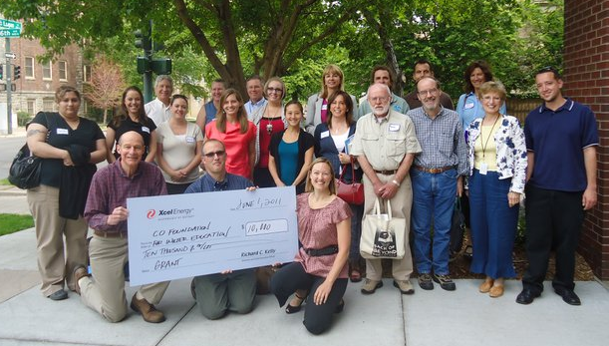
WATER ’22 BUDGET
WSRF funds will be leveraged to raise additional match funding in the form of local community grants and sponsorships from coalition partners, including water utilities and districts, energy utilities, breweries, rafting companies, and others.
Notes:
Water 2012 was approx. $130K with support from 53 different donors. Submitted a WSRF grant back in April, and have support from the Metro BRT as a local sponsor at $5K to match a statewide request of $35K. This gave us the confidence to begin pursuing this project in earnest, where significant additional fundarising will still be required.

Slide 13
WATER ’22 TIMELINE
Water ’22 activities will take place throughout calendar year 2022, for a full year of celebrating and raising awareness about water.
Notes:
Getting a little bit of a late start, but we aren’t starting from scratch. We’ve done this before. We can learn from what was done in Water 2012 and recreate what was successful, and either discard or improve upon what wasn’t

Slide 14
STEERING COMMITTEE
The Steering Committee will meet regularly (twice per month through 2021) to advise on campaign messaging, activities, partnerships, expenditures, etc.
Kaitlyn Beekman Abby Burk | CO Dept. of Public Health and Environment Audubon Rockies |  | kaitlyn.beekman@state.co.us abby.burk@audubon.org
Perry Cabot | Colorado State University Extension |  | Perry.Cabot@colostate.edu
Marielle Cowdin | Colorado River District |  | mcowdin@crwcd.org
Hannah Holm | Colorado Mesa University |  | hhoissalm@coloradomesa.edu
Julie Kallenberger | Colorado Water Center |  | Julie.Kallenberger@colostate.edu
Sara Leonard | CWCB |  | sara.leonard@state.co.us
Ryan Maecker | Colorado Springs Utilities |  | rmaecker@csu.org
Molly Mugglestone | Business for Water Stewardship |  | molly@businessforwater.org
Issamar Pichardo | Conservation Colorado |  | Issamar@conservationco.org
Jayla Poppleton | WEco Executive Director |  | jayla@wateredco.org
Alyssa Quinn | Colorado Water Wise |  | ALQuinn@plattecanyon.org
Patty Rettig | Water Resources Archive, CSU |  | Patricia.rettig@colostate.edu
Elizabeth Schoder | CWCB |  | elizabeth.schoder@state.co.us
Nona Shipman | One World One Water Center |  | nshipman@msudenver.edu
Brian Werner | WEco Board & Program Committee Member |  | brw2024@aol.com
Scott Williamson | WEco Education Programs Manager |  | scott@wateredco.org
Other Partners
Staff has generated a long list of other partners to recruit and Steering Committee review and make additional suggestions.
Notes:
Getting a little bit of a late start, but we aren’t starting from scratch. We’ve done this before. We can learn from what was done in Water 2012 and recreate what was successful, and either discard or improve upon what wasn’t

Slide 15
EARLY MESSAGING THEMES
A unifying message around water – Water connects us all.
Emphasizing uniqueness of Colorado and the pride we have in common.
Tie past, present and future in narrative.
If Water 2012 was about celebrating water, maybe Water ’22 is about activating for water.
Foster a stewardship ethic: This is water we all need to take care of, shared stewardship.
Notes:
Getting a little bit of a late start, but we aren’t starting from scratch. We’ve done this before. We can learn from what was done in Water 2012 and recreate what was successful, and either discard or improve upon what wasn’t

Slide 16
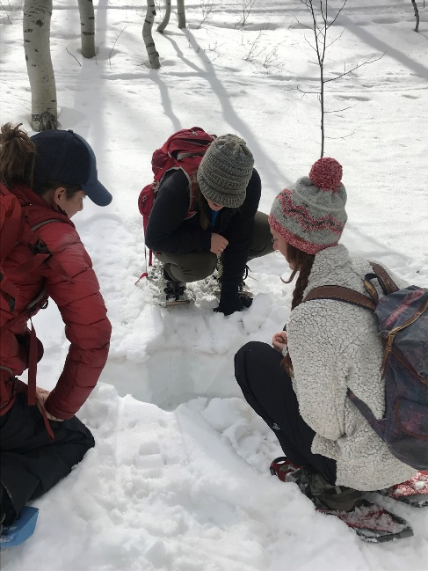

’22 BASIN EVENTS
EMERGING THEMES:
Water connects communities
Issues require collaboration & multi-benefit solutions
Scenarios change outlook
Projects done on “water time”
EMERGING CONSIDERATIONS:
Reach new audiences
Get hands dirty/“Sweat equity”
Feature local food and produce
Awareness vs. comprehensive
Wild card: flight tours
Weather considerations
\
1 event/Basin (9 total), Jan – Sept 2022
WEco subcontract with Brown and Caldwell
Goals:BIP accomplishments, ’22 BIP priorities
Mini tours open to small groups of “influencers”
Coordinate timing/priorities with PEPOs and BRTs
Ideally no cost to attend
Filmed, including post-event reflections

Slide 17
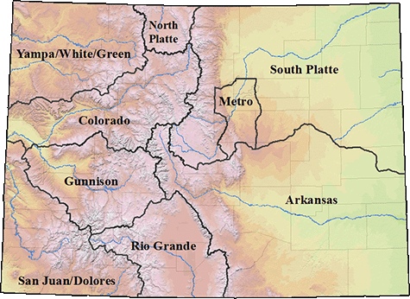
OUTREACH
Initial PEPO/BRT Chair Conversations:
Arkansas
Colorado
Metro
South Platte
Southwest
Yampa/White/Green
Conversations to be scheduled:
Gunnison
North Platte
Rio Grande
Jan-Sept 2022
Outreach to PEPO, BRT
Decide date, mode, location(s)
Arrange local logistics
Contract support as needed
Select & Recruit Participants
Deliver and record events
x 9 Basins

Slide 18
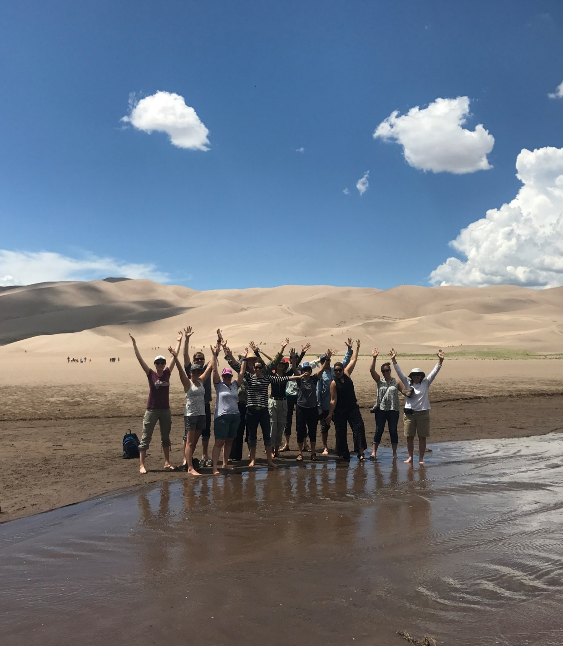
Let’s work together on this!
Jayla Poppleton, WEco Executive Director
Jayla@wateredco.org I 720-325-1448
Scott Williamson, WEco Ed. Programs Manager
Scott@wateredco.org I 303-377-4433
Notes:
Let’s work together on SWEAP. Please reach out and connect with us using the contact information on this slide. Contact Jayla Poppleton or myself, Scott Williamson. Thank you for taking the time to learn about SWEAP. We look forward to connecting with you soon.

